Slide 1
SQL Group by and Sum over()
Submitted By
Maimoona Khilji

Slide 2
GROUP Functions
Types of Group Functions
COUNT
MAX
MIN
STDDEV
SUM
VARIANCE
Syntax:
SELECT group_function (column), ...
FROM table
[WHERE condition]
[ORDER BY column];

Slide 3
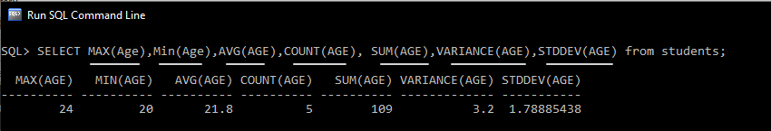
GROUP Functions

Slide 4
GROUP BY
Creating Groups of Data using GROUP BY Clause.
You can divide rows in a table into smaller groups by using the GROUP BY clause.
Syntax:
SELECT column, group_function(column)
FROM table
GROUP BY column;

Slide 5
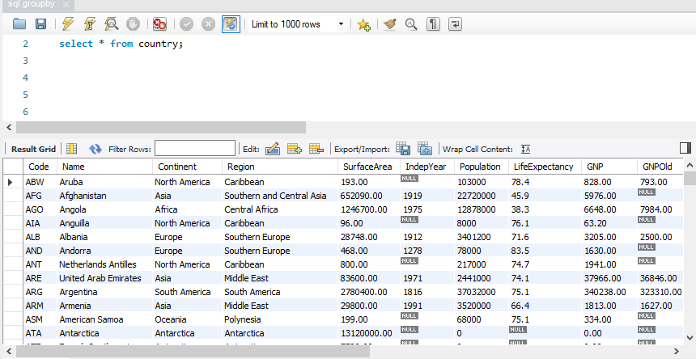
GROUP BY-Example

Slide 6
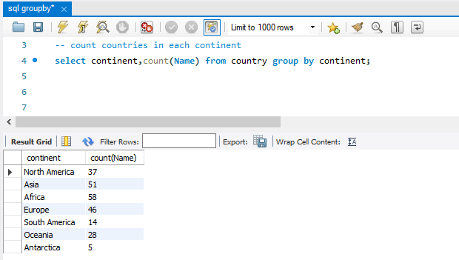
GROUP BY-Example

Slide 7
Group by More than One Column
Using the GROUP BY Clause on Multiple Columns
Syntax:
SELECT columns… , group_function(column)
FROM table
GROUP BY columns… ;

Slide 8
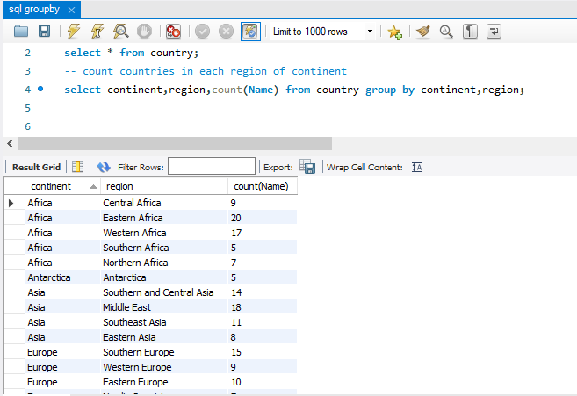
Grouping by More than One Column

Slide 9
Having clause
When you use the HAVING clause, the Oracle server restricts groups as follows:
Rows are grouped.
The group function is applied.
Groups matching the HAVING clause are displayed.
Syntax:
SELECT column, group_function(column)
FROM table
GROUP BY column
Having group_condition;

Slide 10
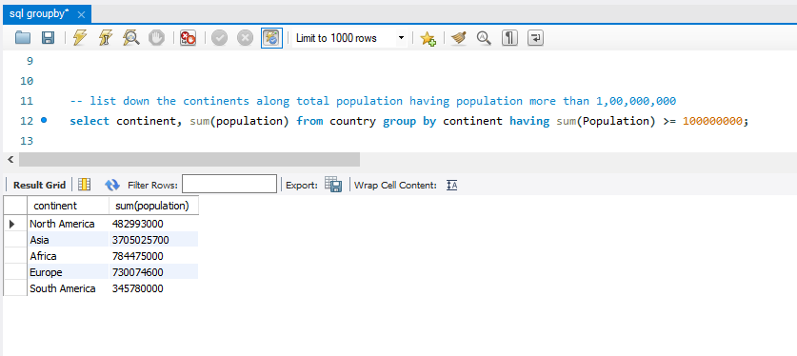
Having clause

Slide 11
OVER Clause
The OVER clause is used to determine which rows from the query are applied to the function, what order they are evaluated in by that function, and when the function's calculations should restart
The OVER() clause can include the following functions:
Partition By: This divides the rows or query result set into small partitions.
Order By: This arranges the rows in ascending or descending order for the partition window. The default order is ascending.
ROW or RANGE: You can further limit the rows in a partition by specifying the start and endpoints.
Syntax:
SELECT column, group_function(column)
OVER ( [ <PARTITION BY clause> ] [ <ORDER BY clause> ] [ <ROW or RANGE clause> ] )
FROM table
Notes:
The OVER clause is used to determine which rows from the query are applied to the function, what order they are evaluated in by that function, and when the function's calculations should restartWhat is over and partition in SQL?

Slide 12
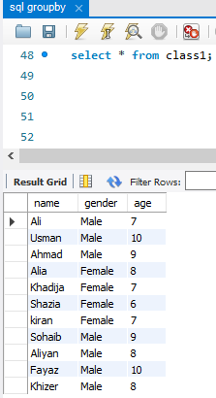
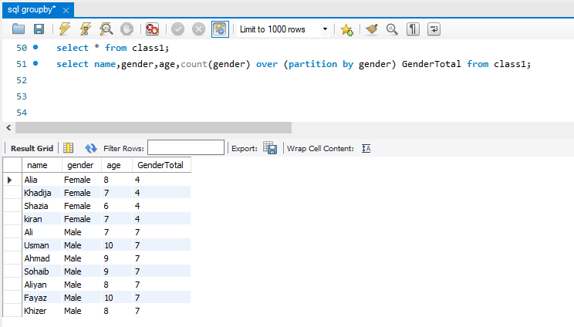
Count OVER - Partition By Clause
Notes:
The OVER clause is used to determine which rows from the query are applied to the function, what order they are evaluated in by that function, and when the function's calculations should restartWhat is over and partition in SQL?

Slide 13
Sum-OVER Clause
The PARTITION BY clause divides the table into partition by specific column.
Once partitions are created, then each partition is applied by the group function.
In this case, group function will be sum.
Syntax:
SELECT columns,
SUM (column) OVER ( PARTITION BY column )
FROM table

Slide 14
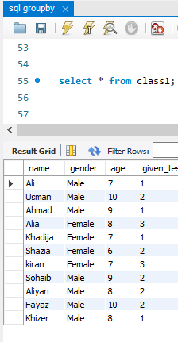
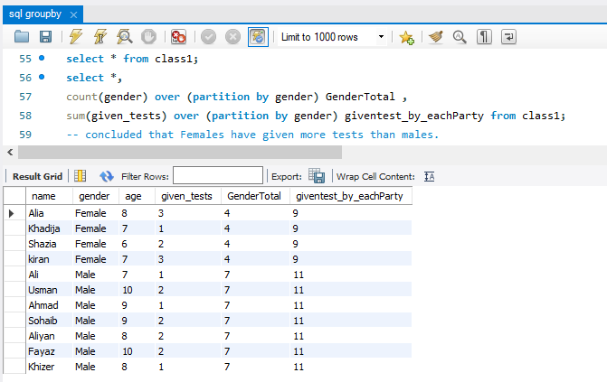
Sum OVER - Partition By Clause
Notes:
The OVER clause is used to determine which rows from the query are applied to the function, what order they are evaluated in by that function, and when the function's calculations should restartWhat is over and partition in SQL?

Slide 15
Group by vs Over
The drawback of group by is that If we select columns that are neither mentioned in group by clause nor applied by group function, then the query will throw error.
PARTITION BY gives aggregated columns with each record in the specified table. If we have 15 records in the table, the query output SQL PARTITION BY also gets 15 rows. On the other hand, GROUP BY gives one row per group in result set.
PARTITION BY retrieves all the records in the table, while the GROUP BY only returns a limited number.
One more thing is that GROUP BY does not allow to add columns which are not parts of GROUP BY clause in select statement. However, with PARTITION BY clause, we can add required columns.

Slide 16
References
https://www.guru99.com/group-by.html
https://www.w3schools.com/sql/sql_having.asp
https://learnsql.com/blog/sql-over-clause/
https://docs.microsoft.com/en-us/sql/t-sql/queries/select-over-clause-transact-sql?view=sql-server-ver16
https://www.youtube.com/watch?v=KwEjkpFltjc

Slide 17
Questions
What is the difference between WHERE and HAVING in SQL?
2 points to show the difference:
Having is use ONLY for columns that is used in group by clause while where is use for the ones not included in group
Position of where is before the group by in query... While having is written after the group by clause
What will this qry return?SELECT department, month, AVG(salary) AS average_salaryFROM salariesGROUP BY department;
I guess it will throw error as month is not included in groupby
Neither any group function is applied on it

Slide 18
Summary
So today, I learned the concepts of Group By and sum over ( ).
The short summary about today‘s topic is that we use GROUP BY clause to convert the rows into partition or smaller groups. But the drawback of group by is that If we select columns that are neither mentioned in group by clause nor applied by group function, then the query will throw error.
While the over clause is used to apply group functions over specific partition. We can use partition by, order by and row or range with over ( ). The benefit of partition clause is that we can add additional columns as well in select statement.
The OVER clause is used to determine which rows from the query are applied to the function, what order they are evaluated in by that function, and when the function's calculations should restart

Slide 19
THE END

